Slide 1
THE IMPACTS OF THE US-CHINA TRADEWAR ON US ELECTRICAL MANUFACTURE INDUSTRY
Final Project Presentation
73-270:Professional Communication for Economists
Yuhao Chen
December 3rd, 2019

Slide 2

NEMA as an important part of US economy
325 firms
370,000 jobs
$124 billion
Source: NEMA, 2019
Notes:
The National Electrical Manufacturers Association (NEMA) represents nearly 325 electrical equipment and medical imaging manufacturers that make safe, reliable, and efficient products and systems serving seven major markets. Our combined industries account for 370,000 American jobs in more than 6,100 facilities covering every state. These industries produce $124 billion in shipments and $42 billion in exports of electrical equipment and medical imaging technologies per year.

Slide 3
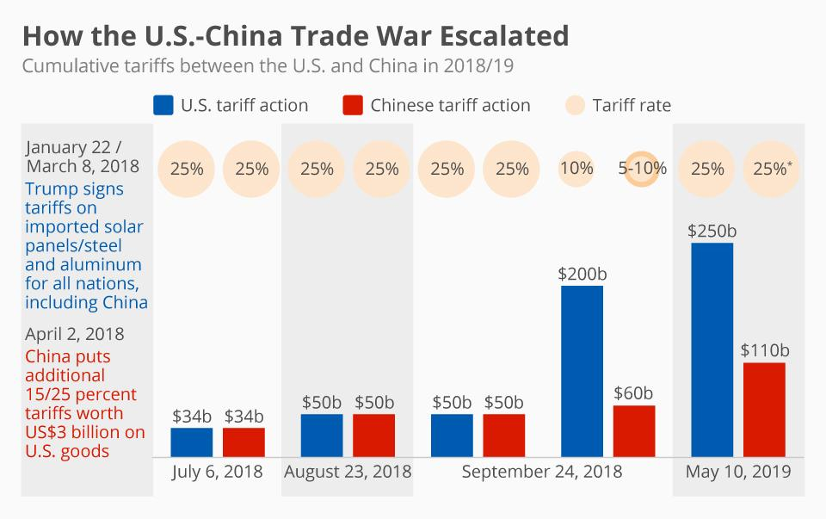
Trade War Recap
Source: BBC, 2019
Notes:
Since United States has established diplomatic relations with China since 1979, two countries signed free trade agreement for improving national welfare. After Trump became the president in 2016, the United States government began to take action to end this free trade relationship.
On March 22th, 2018, Trump announced tariff US$60 billion worth of China goods because there was a huge trade deficit and China companies have been stealing business secrets and technology from United States companies. As the China government fought back with tariff, the trade war started and became severer. Although there are several trade talks, no actual progress is achieved.

Slide 4
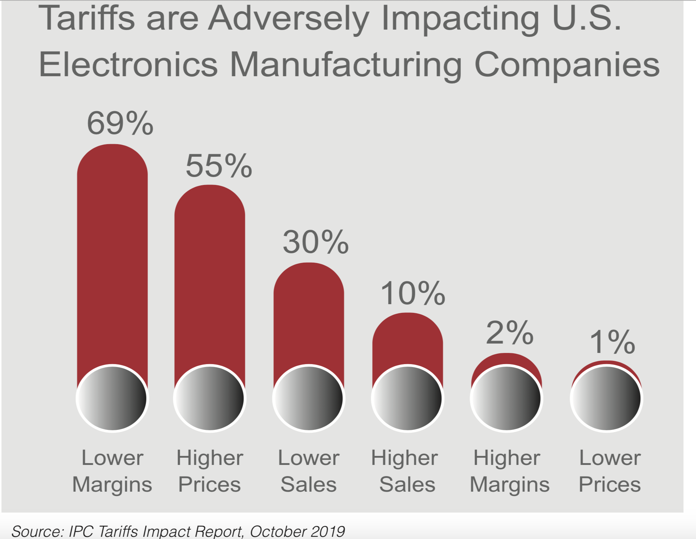
Electrical Manufacture Industry’s Downturn
Notes:
Industry revenue is expected to decline at an annualized rate of 1.2%.
First, the tariff increase the direct cost of imports. Furthermore, the high tariff increase the indirect cost by bringing extra administrative and operational burdens to electrical manufacture industry.

Slide 5
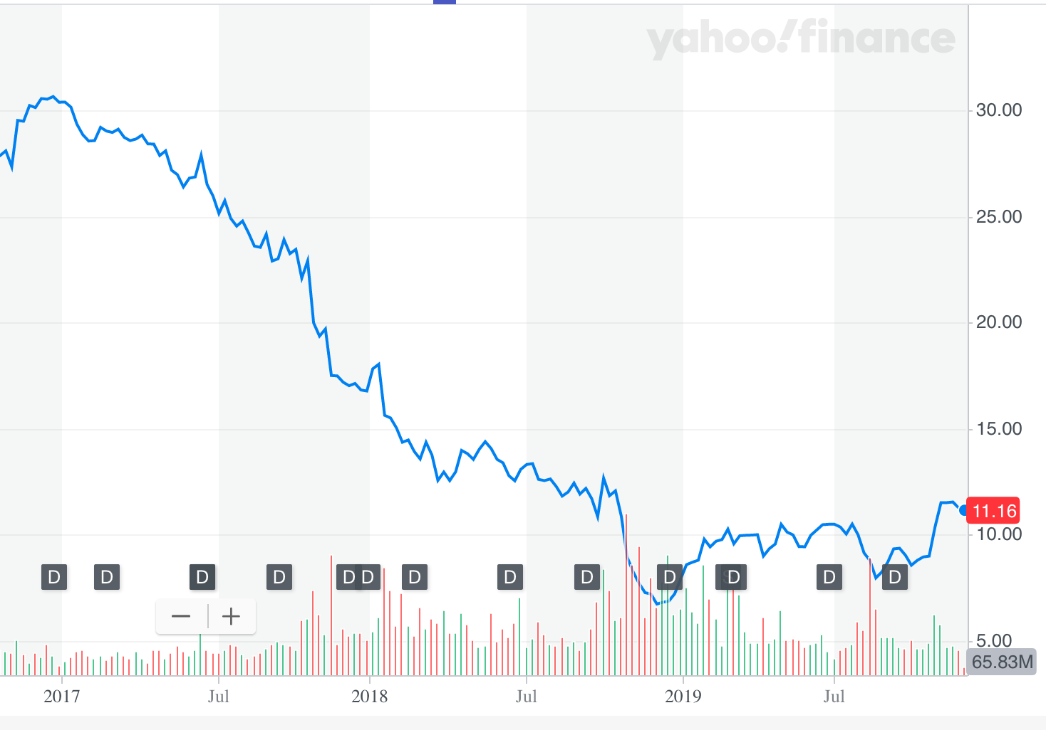
GE’s Financial Downturn
Source: Yahoo Finance
Notes:
Stock price decrease greatly. Also, the company had experienced an increase of net loss from 0.72 million dollars and 2.62 million dollars. GE executives did not anticipate that president Trump will hit China with such tariff. GE executives did not anticipate that president Trump will hit China with such tariff.

Slide 6
KPMG’s Solution to Tariff
Product exclusion requests
Country of origin adjustments
Value reduction/First sale tactics
Strategic sourcing
20% Less Tariff!
Notes:
KPMG’s solution:…
GE make use of all of them and achieve a 20% percent. However, they find that sometimes China import is the cheapest and with best quality even with the tariff.

Slide 7
173 Footwear Firms’ Appeal
“On behalf of our hundreds of millions of footwear consumers and hundreds of thousands of employees, we ask that you immediately stop this action to increase their tax burden. Your proposal to add tariffs on all imports from China is asking the American consumer to foot the bill. It is time to bring this trade war to an end. ” (BBC, 2019)
Notes:
Our recommendation is that NEMA should call on US government and China government to return to negotiation and stop the trade war. 173 footwear firms, including global giants Nike and Adidas, wrote an letter to ask president Trump stop increasing tax burden.

Slide 8
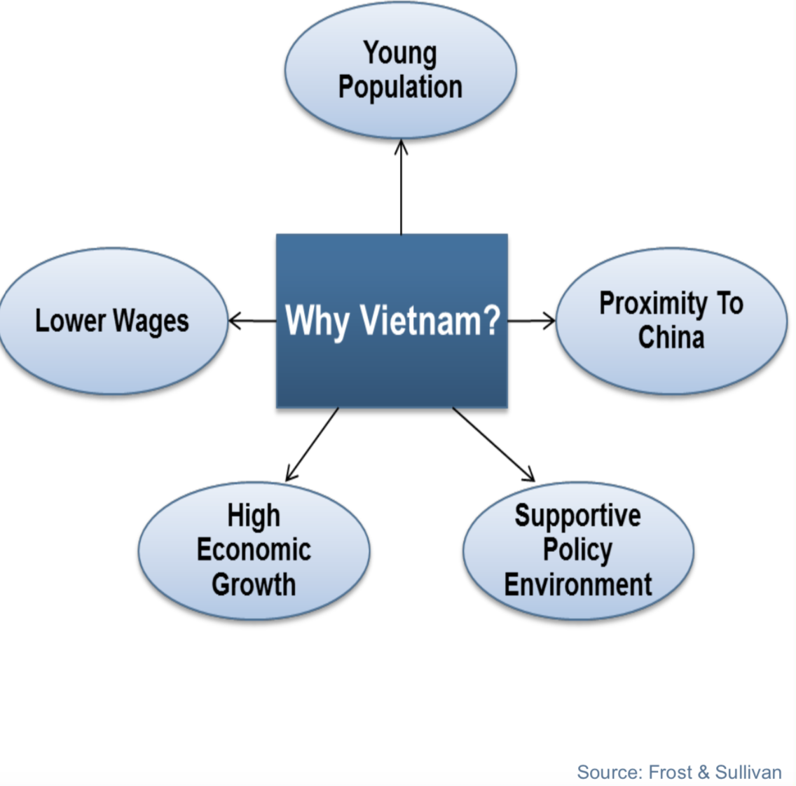
Sourcing from SEA, especially Vietnam
Notes:
If the trade war continues, NEMA members may consider choose SEA region over United States, Europe and China due to lower wages and geographical advantage.

Slide 9
Thank You

